Slide 1
Learning Objective
I will be able to identify features of a pdf of the normal distribution
Success Criteria
At the end of the lesson, I will be able to:
4.2.5 identify contexts, such as naturally occurring variation, that are suitable for modelling by normal random variables
4.2.6 identify features of the graph of the probability density function of the normal distribution with mean μ and standard deviation σ and the use of the standard normal distribution
4.2.7 calculate probabilities and quantiles associated with a given normal distribution using technology, and use these to solve practical problems

Slide 2
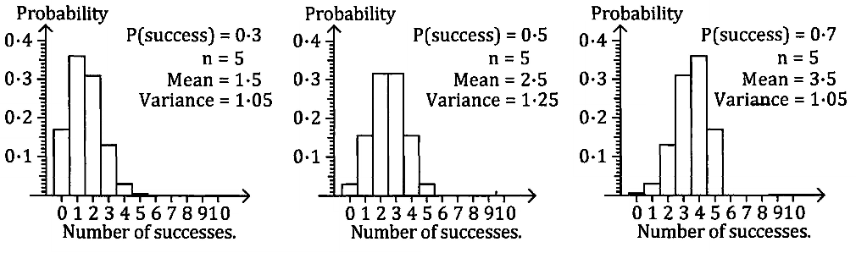
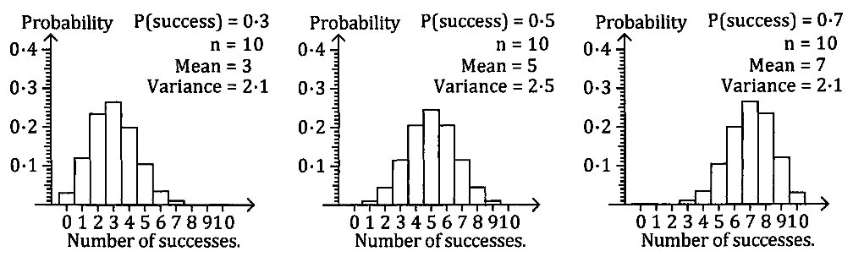
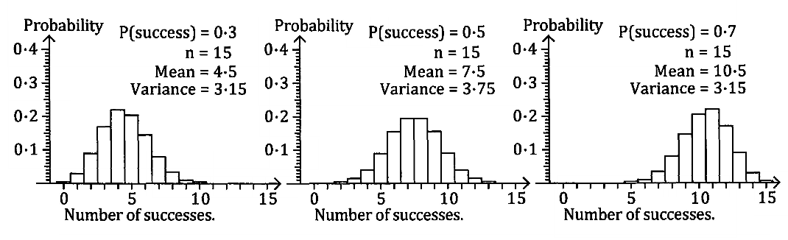
From Binomial to Normal
Recall from studying binomial distributions, when increasing the sample size in our experiments, our data starts to become symmetrical in shape with the probability of success being roughly at the centre.
This bell-shaped curve that it approximates to what we call the normal distribution.

Slide 3
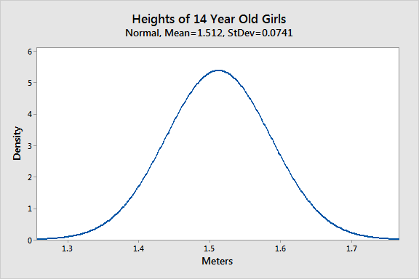
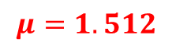
The Normal Distribution
It is used to describe naturally occurring phenomena, such as blood pressure, IQ, heights and weights of individuals etc, where we would observe that the majority of the data is centred around the mean score.
The normal distribution is a bell-shaped curve where all the data is evenly spread above and below the mean. In other words, 50% of the data will be above and 50% will be below the mean.
$$μ=1.512$$

Slide 4
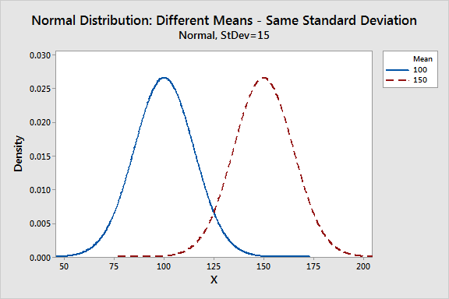
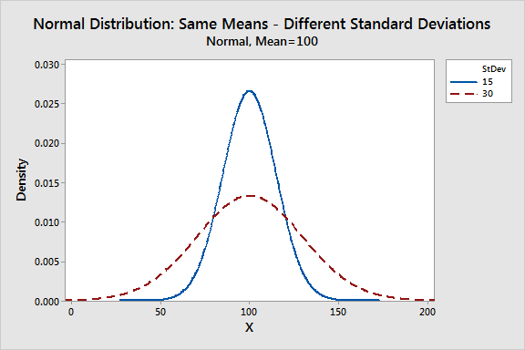
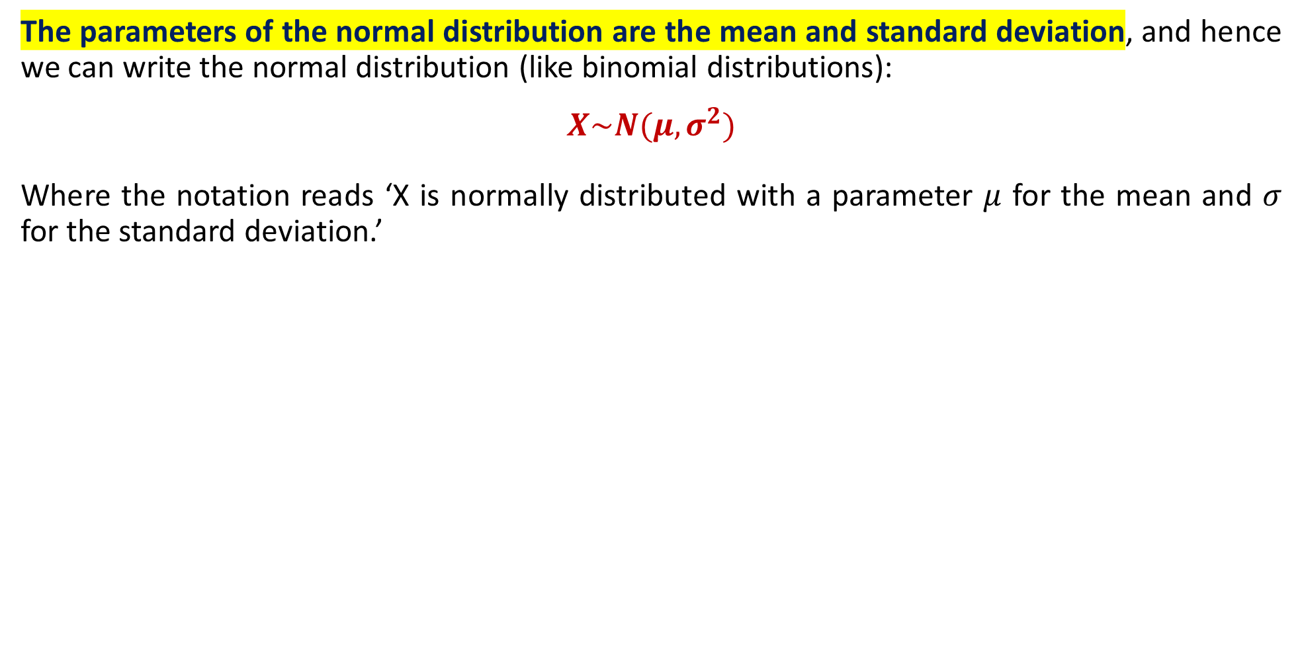
The Normal Distribution
The affect of the mean in a normal distribution is that it changes the overall position of the bell-curve (but not the shape).
The affect of the standard deviation in a normal distribution is that it changes the spread of the data. A smaller standard deviation will make the peak taller, so that more data is clustered near the mean. A large standard deviation will compress the bell-curve so that data is more spread out.
The parameters of the normal distribution are the mean and standard deviation, and hence we can write the normal distribution (like binomial distributions):
$$X\sim N(μ,σ^{2})$$
Where the notation reads ‘X is normally distributed with a parameter $μ$ for the mean and $σ$ for the standard deviation.’

Slide 5
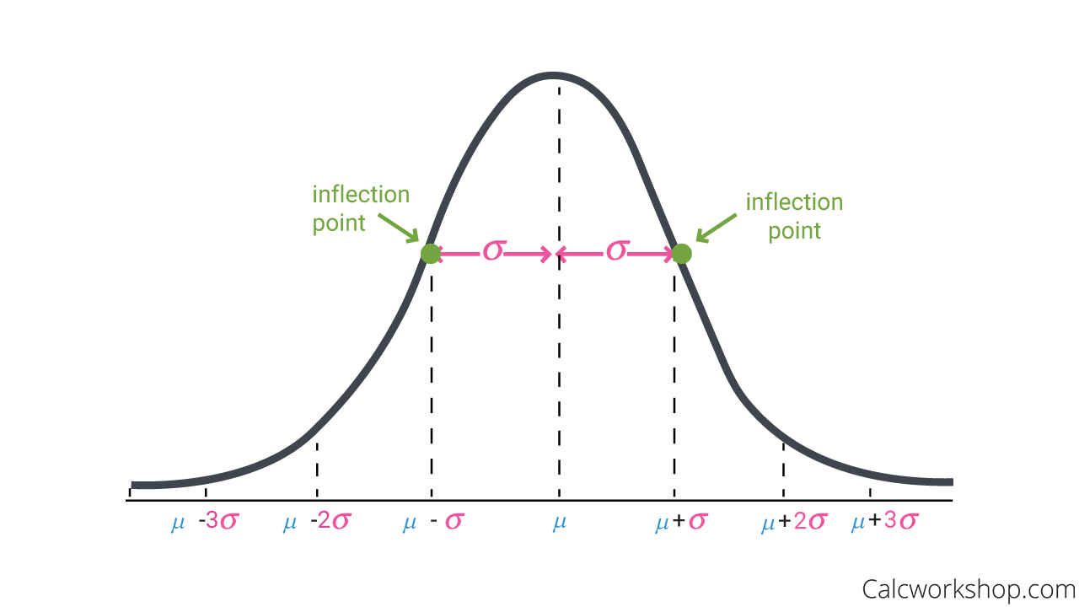
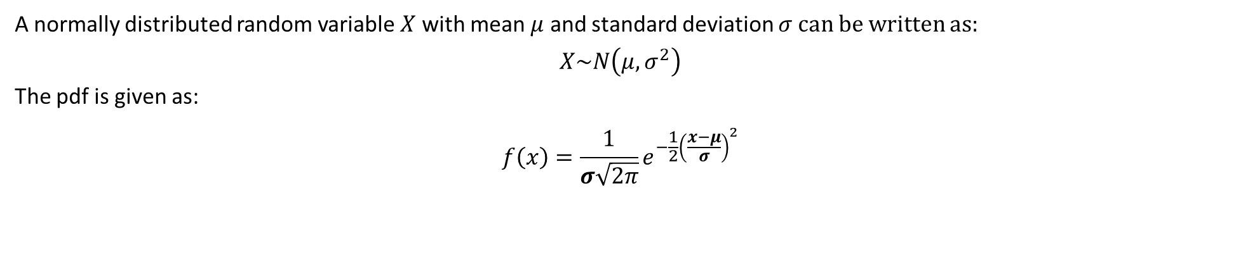

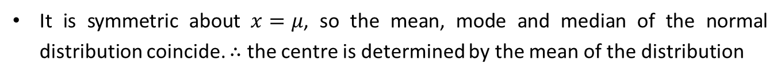
The General Normal Distribution
A normally distributed random variable $X$ with mean $μ$ and standard deviation $σ$can be written as:
$$X\sim N\left(μ, σ^{2}\right)$$
The pdf is given as:
$$f\left(x\right)=\frac{1}{σ\sqrt{2π}}e^{−\frac{1}{2}{\left(\frac{x−μ}{σ}\right)}^{2}}$$
Properties of a Normal Distribution
The graph of a normal distribution is symmetric and bell-shaped
It has an asymptote of $y=0$
It is symmetric about $x=μ$, so the mean, mode and median of the normal distribution coincide. $∴$ the centre is determined by the mean of the distribution
The width is determined by the standard deviation. The points of inflection of the curve are located one SD on either side of the mean.
The larger the value of the SD, the greater the spread of the curve.
Total area under the curve is unity, that is 1.
Probability that $X$ between $c$ and $d$ is given by:
$$P\left(c<X<d\right)=\int_{c}^{d}{\frac{1}{σ\sqrt{2π}}e^{−\frac{1}{2}{\left(\frac{x−μ}{σ}\right)}^{2}}}dx$$

Slide 6
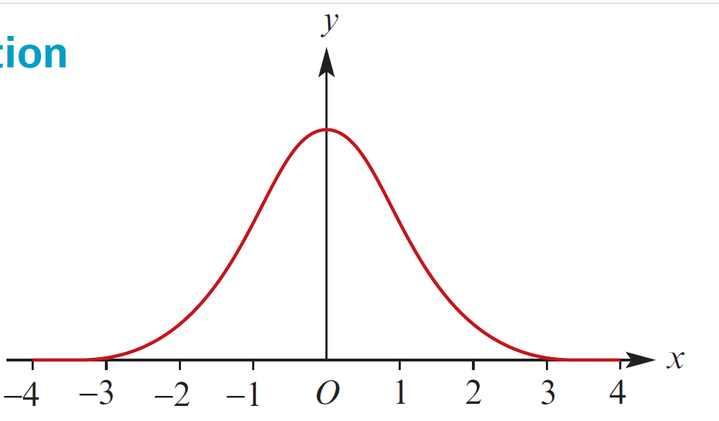
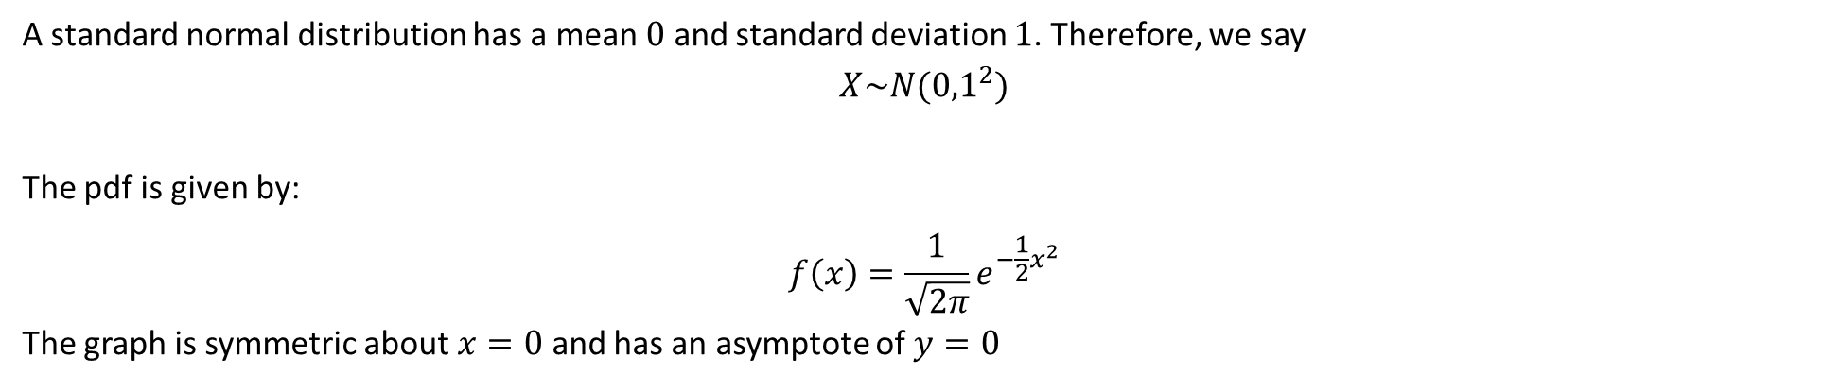
The Standard Normal Distribution
A standard normal distribution has a mean $0$ and standard deviation $1$. Therefore, we say
$$X\sim N({0,1}^{2})$$
The pdf is given by:
$$f\left(x\right)=\frac{1}{\sqrt{2π}}e^{−\frac{1}{2}x^{2}}$$
The graph is symmetric about $x=0$ and has an asymptote of $y=0$

Slide 7
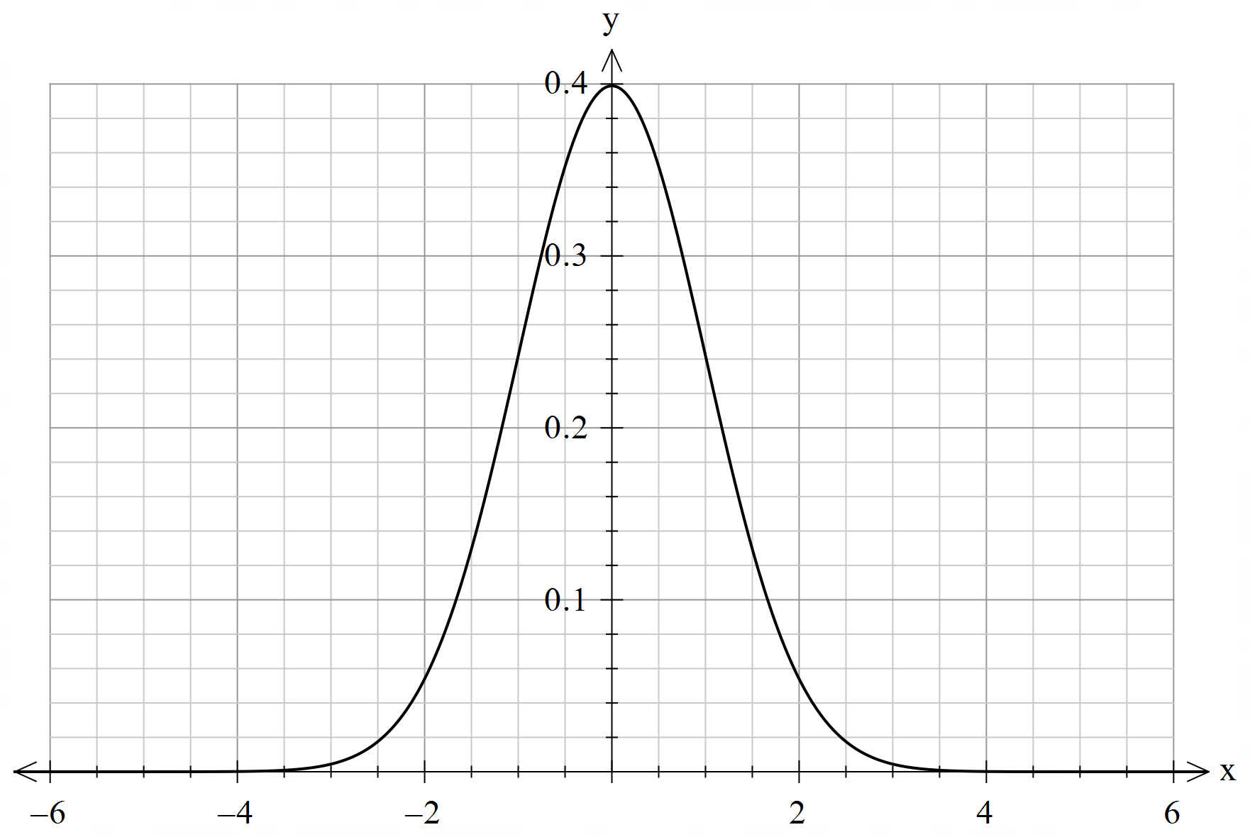
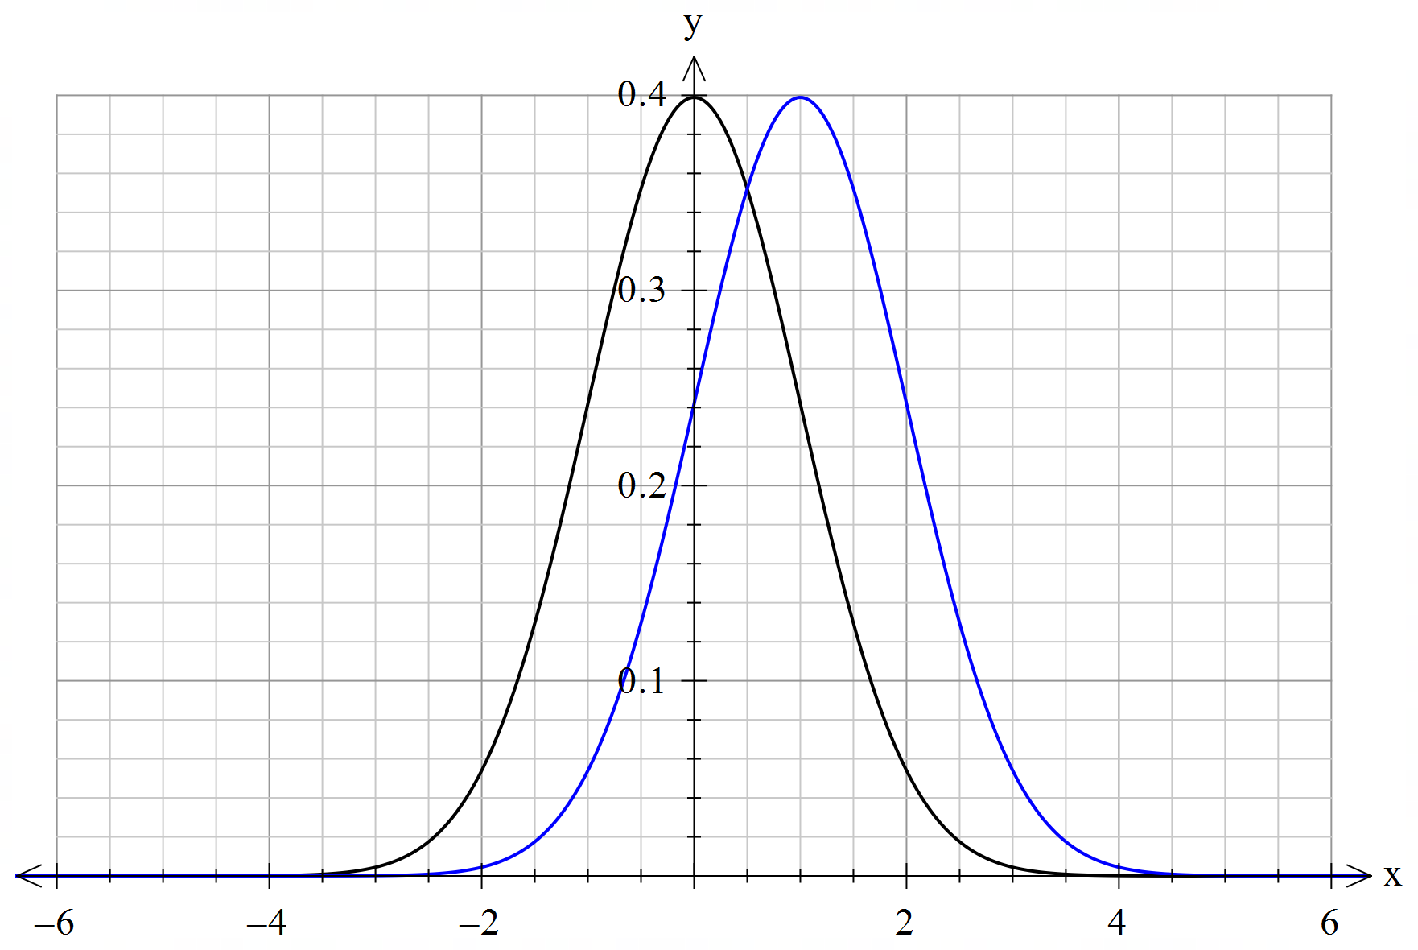
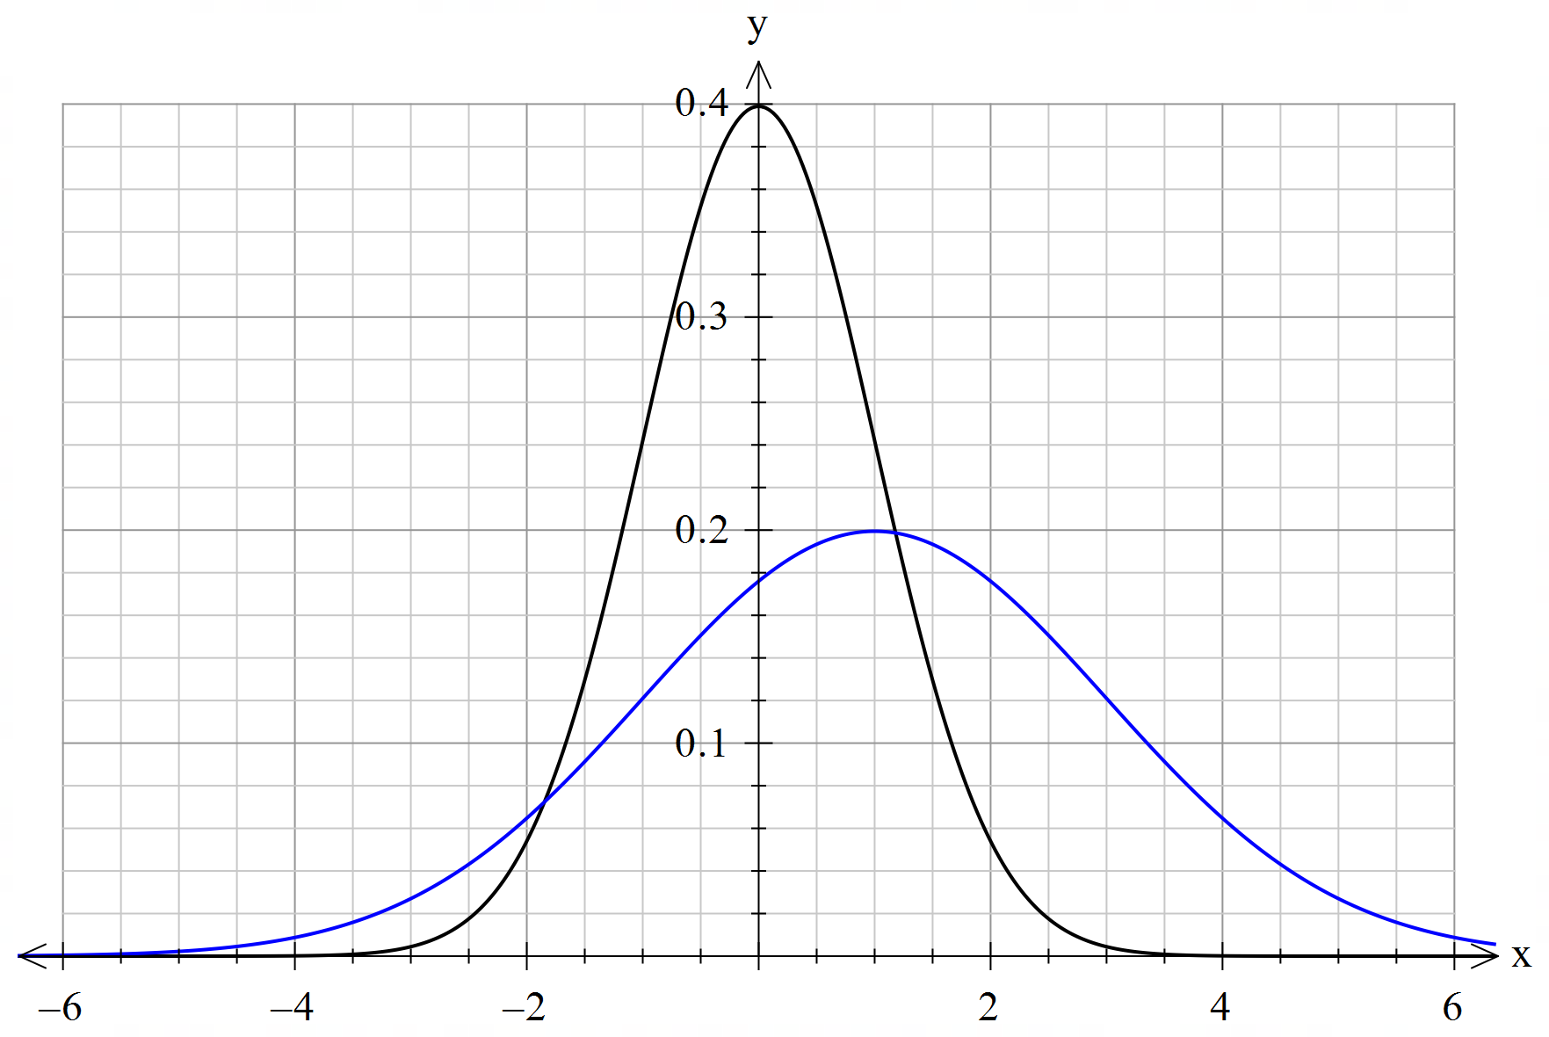
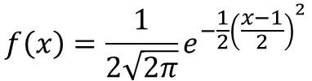
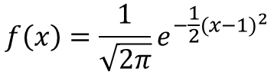
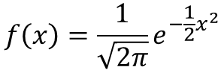
Guided Practice
On the same set of axes, sketch the graphs of the PDF of the standard normal distribution and the normal distribution with
Mean 1, and standard deviation 1
Mean 1 and standard deviation 2
$$f\left(x\right)=\frac{1}{\sqrt{2π}}e^{−\frac{1}{2}x^{2}}$$
$$f\left(x\right)=\frac{1}{\sqrt{2π}}e^{−\frac{1}{2}{(x−1)}^{2}}$$
$$f\left(x\right)=\frac{1}{2\sqrt{2π}}e^{−\frac{1}{2}{\left(\frac{x−1}{2}\right)}^{2}}$$

Slide 8
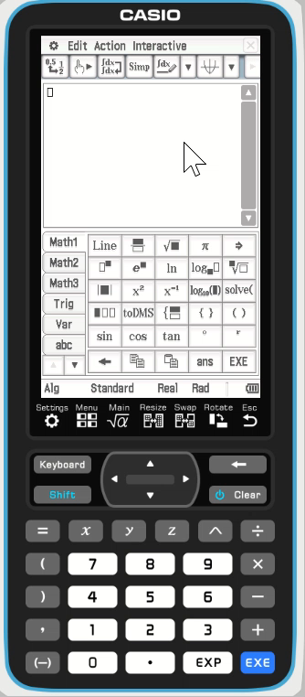
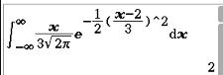
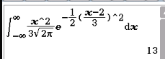
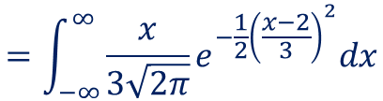
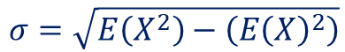
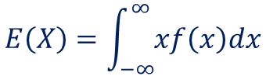
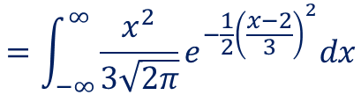
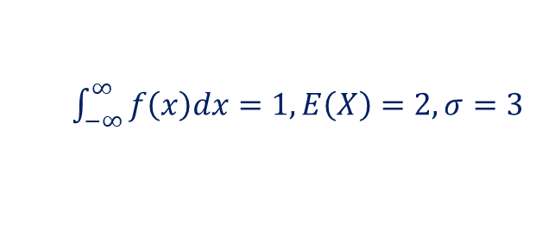

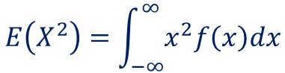
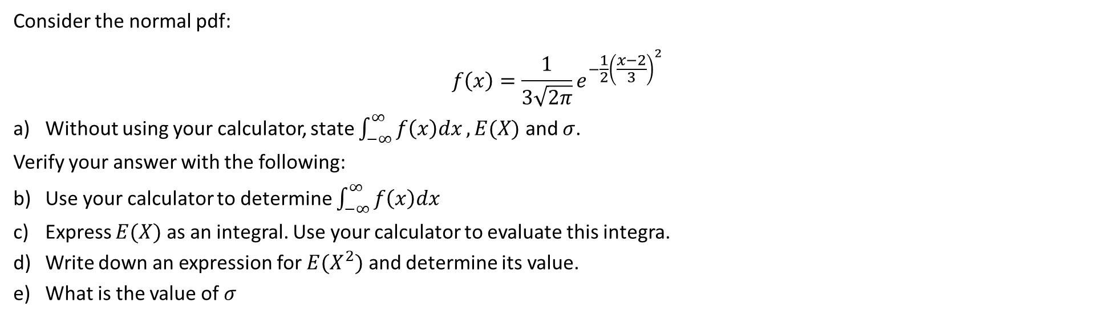
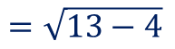
Guided Practice
Consider the normal pdf:
$$f\left(x\right)=\frac{1}{3\sqrt{2π}}e^{−\frac{1}{2}{\left(\frac{x−2}{3}\right)}^{2}}$$
Without using your calculator, state $\int_{−∞}^{∞}{f\left(x\right)dx}, E(X)$ and $σ$.
Verify your answer with the following:
Use your calculator to determine $\int_{−∞}^{∞}{f\left(x\right)dx}$
Express $E(X)$ as an integral. Use your calculator to evaluate this integra.
Write down an expression for $E(X^{2})$ and determine its value.
What is the value of $σ$
$\int_{−∞}^{∞}{f\left(x\right)dx}=1, E\left(X\right)=2, σ=3$
$$E\left(X\right)=\int_{−∞}^{∞}{xf\left(x\right)dx}$$
$$E\left(X^{2}\right)=\int_{−∞}^{∞}{x^{2}f\left(x\right)dx}$$
$$σ=\sqrt{E\left(X^{2}\right)−\left(E{\left(X\right)}^{2}\right)}$$
$$=\int_{−∞}^{∞}{\frac{x}{3\sqrt{2π}}e^{−\frac{1}{2}{\left(\frac{x−2}{3}\right)}^{2}}dx}$$
$$=\int_{−∞}^{∞}{\frac{x^{2}}{3\sqrt{2π}}e^{−\frac{1}{2}{\left(\frac{x−2}{3}\right)}^{2}}dx}$$
$$=\sqrt{13−4}$$
$$=3$$

Slide 9
Independent Practice
Complete Cambridge Ex 11A

